Slide 1
YouTube Thumbnail Downloader
MINI PROJECT
FULL STACK WEB DEVELOPMENT

Slide 2

KAMLA NEHRU INSTITUTE OF TECHNOLOGY, SULTANPUR
Name- Narayan Jaiswal
Roll No.- 20627
Branch- Information Technology
Email- narayan.20627@knit.ac.in
Professor-
Date- 23 Dec. 2021

Slide 3
PHP Based YouTube Thumbnail Downloader
Full Stack Website With a Beautiful User Interface.
No Advertisement in whole Website.
Payment Gateway Integration by Razor pay Button.
Complete Production Based Development & Hosting.
YouTube Thumbnail Downloader Website –
https://ytthumbnaildownload.000webhostapp.com/

Slide 4
Briefing Up:
Concepts Used:
# Web Development (Frontend & Backend).
# Deployment on server.
Languages Used:
# PHP (For Backend).
# HTML,CSS & JS (Front end Website Development).

Slide 5
About Website:
Other Resources:
# Hosted on free Web Server.
# VS Code.
Website Framing:
# HTML,CSS & JS for Frontend.
# PHP for Backend.

Slide 6
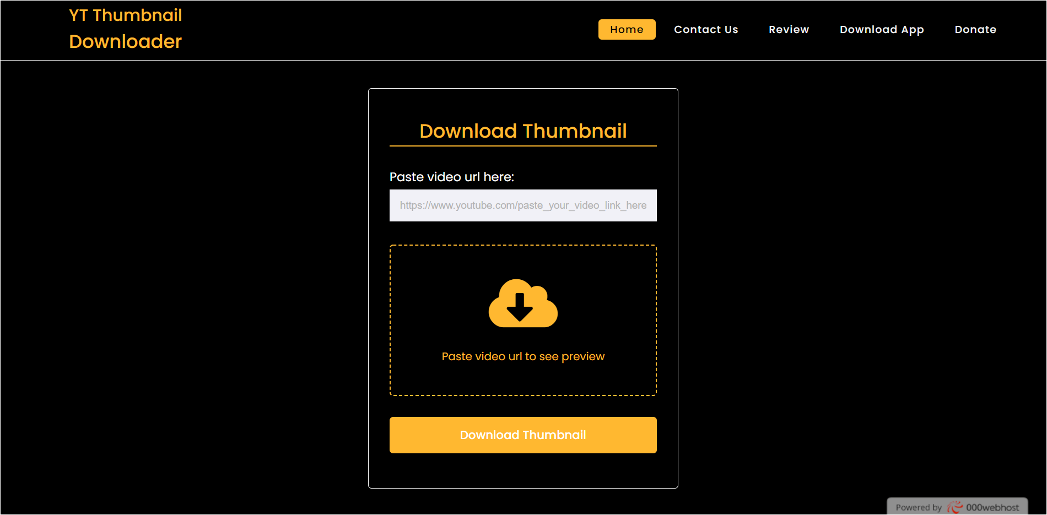
LINK
https://ytthumbnaildownload.000webhostapp.com/

Slide 7
Home Page

Slide 8
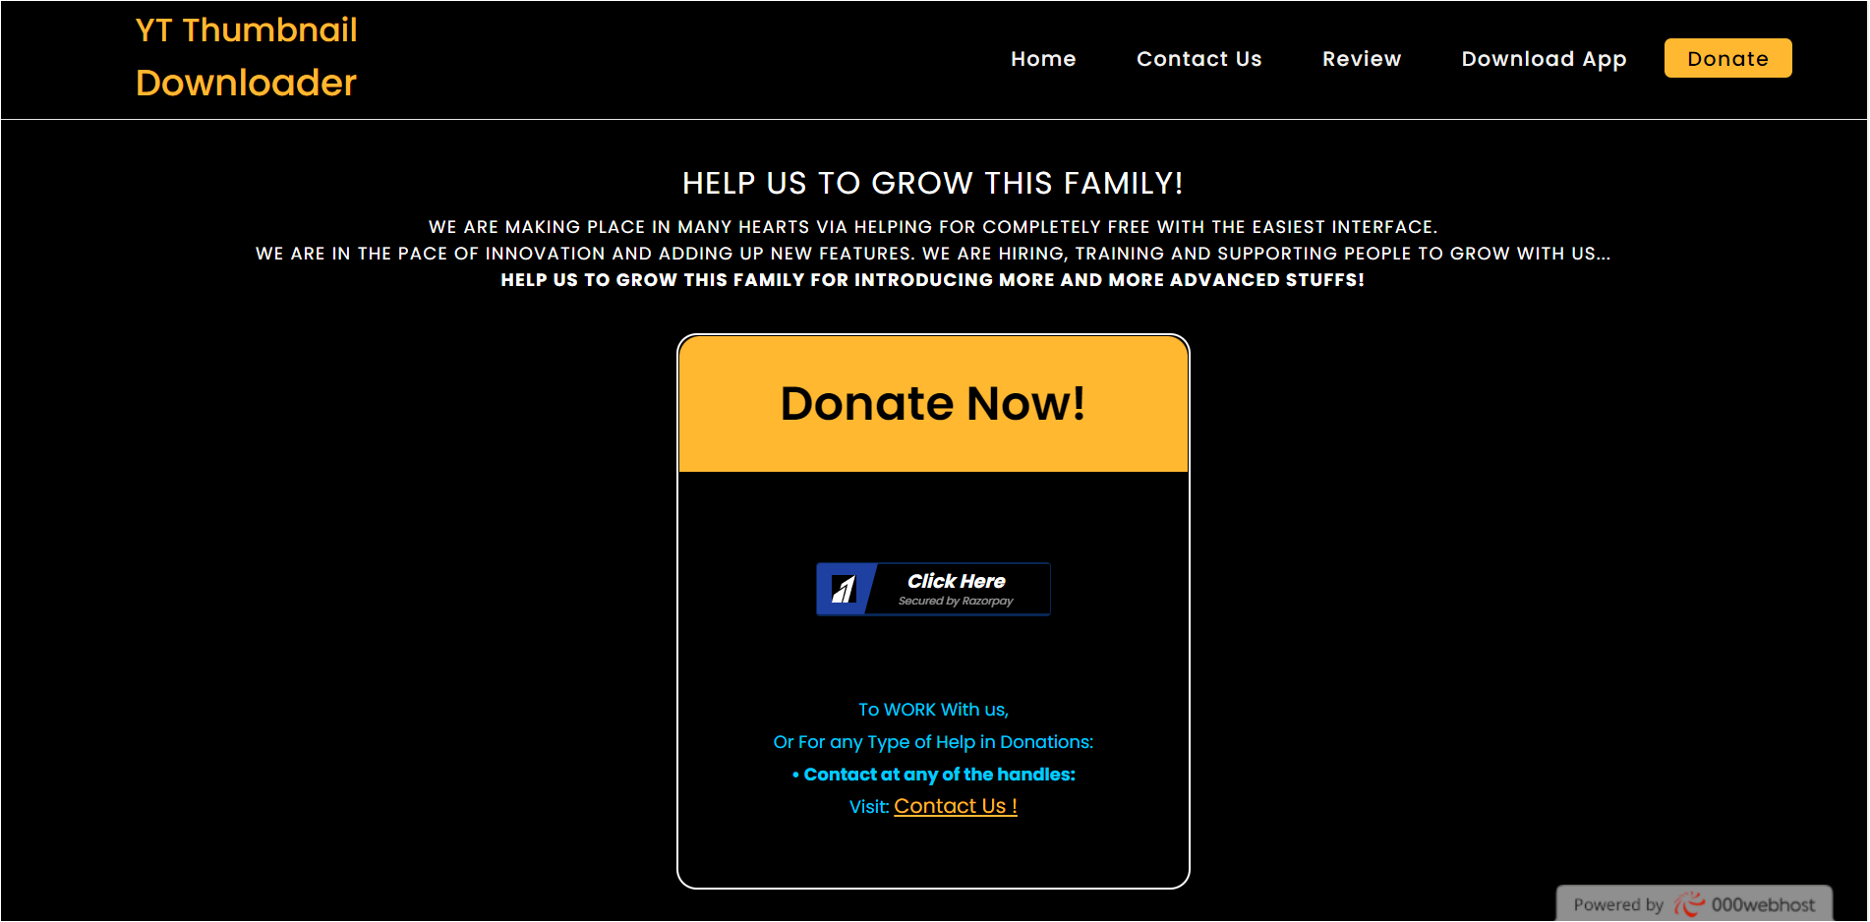
Payment Gateway:

Slide 9
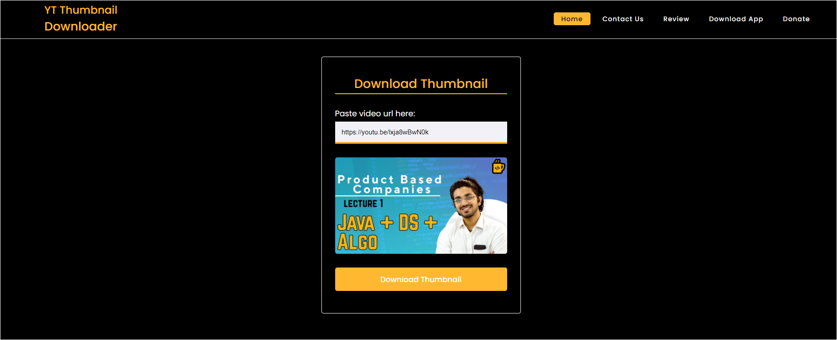
Downloading Popup:

Slide 10
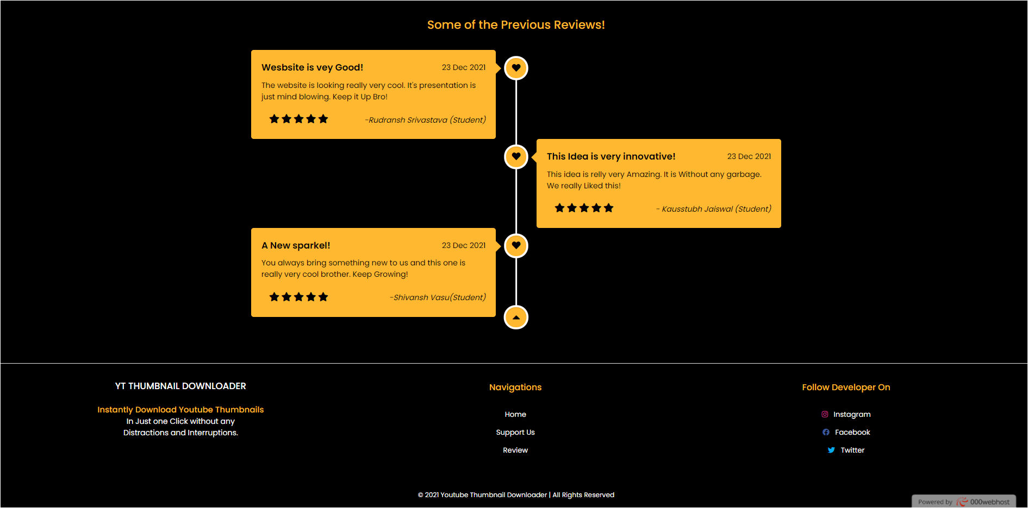
Reviews:

Slide 11
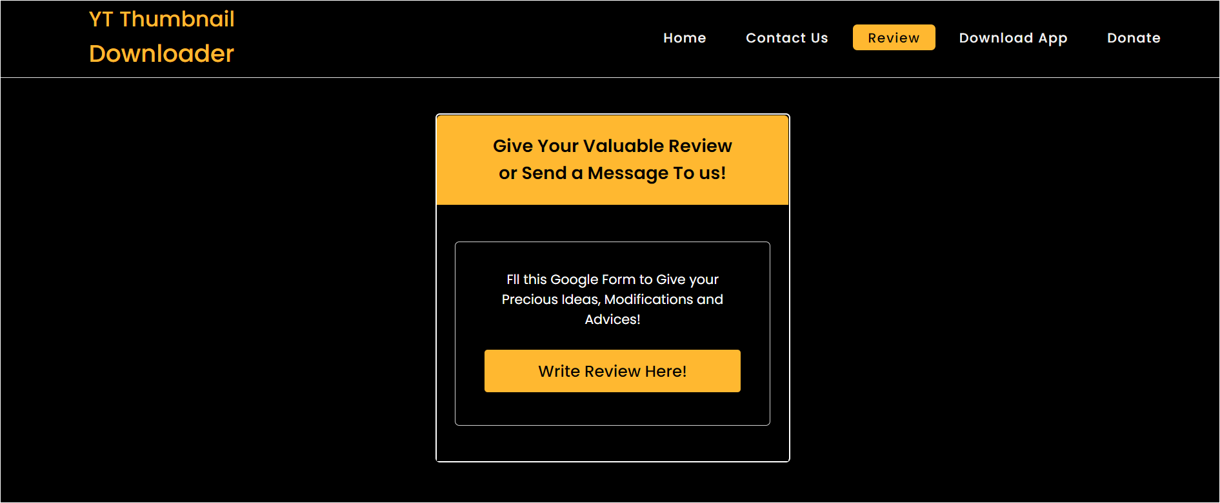
Review Collection Page:

Slide 12
Links & URLs:
🌐Visit the website: https://ytthumbnaildownload.000webhostapp.com/
📨Connect us: https://ytthumbnaildownload.000webhostapp.com/review.php
🧩Contact Creator: https://ytthumbnaildownload.000webhostapp.com/developer.php
Payment: https://ytthumbnaildownload.000webhostapp.com/supportus.php

Slide 13
THANKYOU !
PPT Created On - Google Slides

